Slide 1
SDSS
Hardware designing and implementation

Slide 2
Uses of Phase Sequences
To Determine the type of fault (+/-/0)
+ Sequence:
Harmonic free operation
Unity PF operation
- Sequence
To balance current/voltage imbalance
Zero Sequence
Earth faults

Slide 3
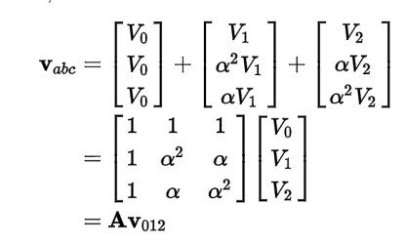


Decomposition
Fortescue Theorem
Use A⁻¹ to calculate V₀₁₂
Simple past time relation to calculate sequences
Susceptible to varied sensitivity at different samples

Slide 4

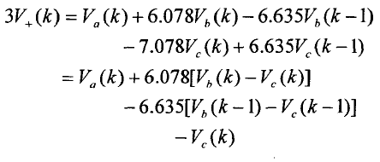
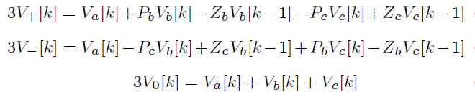
Fast Decomposition
Use of recursive relation to reduce the phase between samples
Our implementation goes from 120 deg. to 7.5 deg. reduction
Results in a difference relation
Will be implemented as a module in verilog

Slide 5
Component 1: Seq Comp Extractor
Calculate sequence components using fast recursion methods, rather than window based inaccurate Fortescue equation

Slide 6
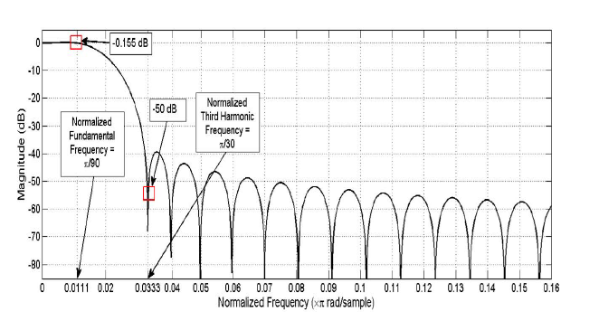
Component 2: FIR Filter
180 Order filter with following characteristics
Gain around central frequency -0.155dB
Cut- off around 3f_{central} with gain -50dB

Slide 7
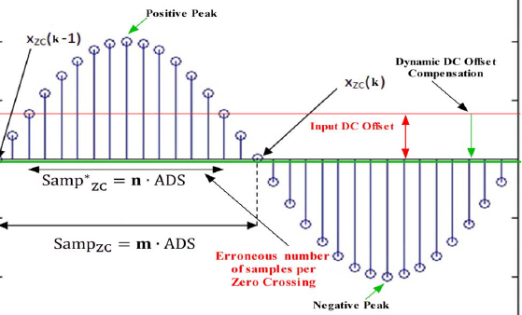
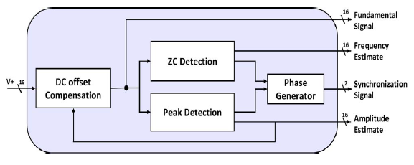
Component 3: D-ZCPD
Zero crossing and peak detection
Zero crossing in a particular time detects signal frequency
Frequency allows phase calculation at any instant
Peak Detector calculates amplitude of phasor

Slide 8

Component 4: Ada Down Sampler
Input signal frequency can vary greatly
Sampling frequency of the signal for decomposition should be adaptive
This signal should control the clk frequency for all our modules

Slide 9
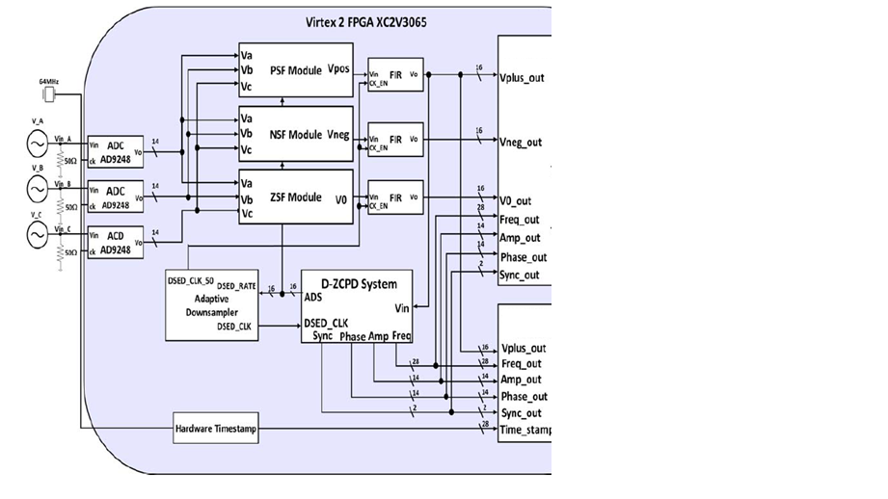
Combining all Modules
SCE , FIR, ZCPD, AdaSampler
All are connected as shown
Create and check all modules
D/A for V+/V-/V0 signals
To control circuit, depending on
application

Slide 10
Till Next Time…
Results of all the modules separately
Performance adjustments for FIR

Slide 11
Results: Simulink Block Diagram

Slide 12
Results: SCE (Seq. Extractor)
Implementing thsese:

Slide 13
Results: ZCPD
This block calculates:
V1 amplitude
V1 phase
V1 estimated frequency

Slide 14
Results: Combining SCE and ZCPD
Phases:
A->0
B->0
C->0

Slide 15
Results: Combining SCE and ZCPD
Phases:
A->0
B->200
C->80

Slide 16
Results: Combining SCE and ZCPD
Phases:
A->0
B->180
C->0

Slide 17
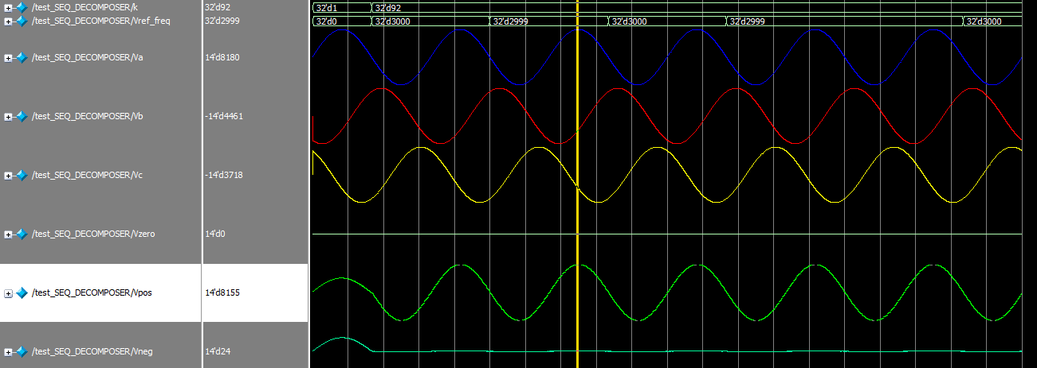
Results: Combining SCE and ZCPD
30 Hz

Slide 18
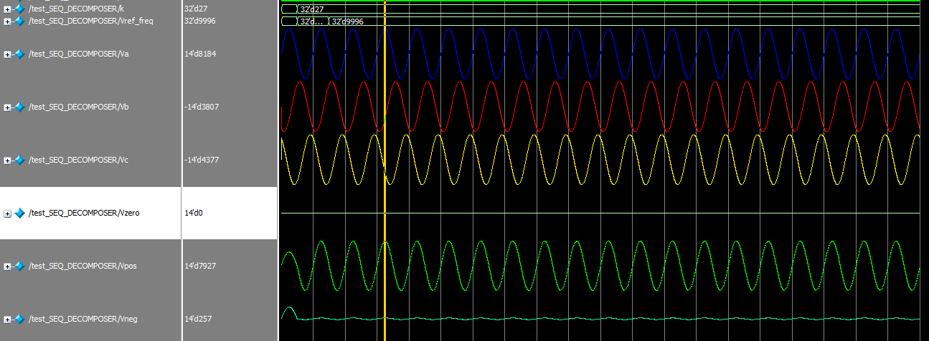
Results: Combining SCE and ZCPD
100 Hz

Slide 19
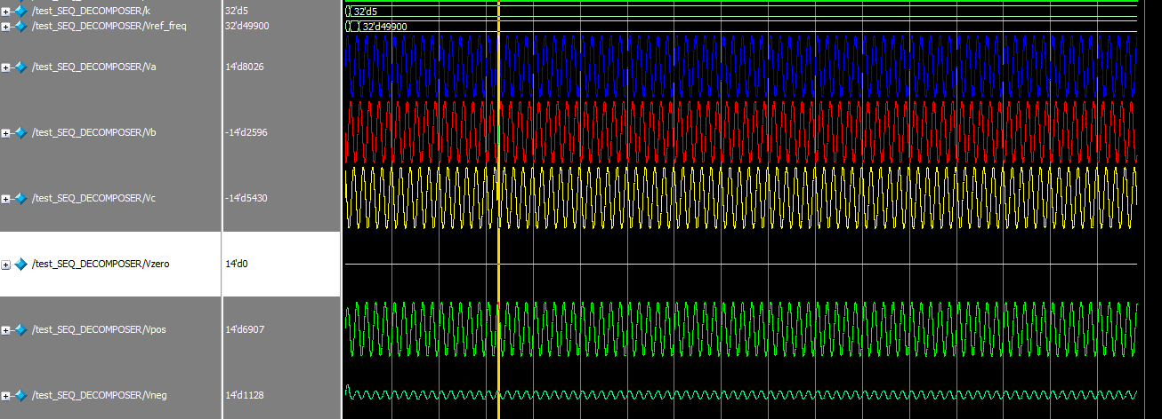
Results: Combining SCE and ZCPD
500 Hz

Slide 20
Results: FIR Standalone
===➔

Slide 21
Results: FIR Standalone

Slide 22
Further Work
Combining the FIR performance with the SCE-ZCPD system so that input signal can have harmonics
Using ADS to see if results are consistent with varied frequency
Create a state controller for this module system with states like:
ADC Sampling
Output Produced state/ IDLE state, etc
Burn the working machine into a board and test

